Slide 1
Chemical Equilibrium
Describing Chemical Equilibrium
Chemical Equilibrium—A Dynamic Equilibrium
The Equilibrium Constant
Heterogeneous Equilibria; Solvents in Homogeneous Equilibria
Using the Equilibrium Constant
Qualitatively Interpreting the Equilibrium Constant
Predicting the Direction of Reaction
Calculating Equilibrium Concentrations
Changing the Reaction Conditions; Le Châtelier’s Principle
Removing Products or Adding Reactants
Changing the Pressure and Temperature
Effect of a Catalyst

Slide 2
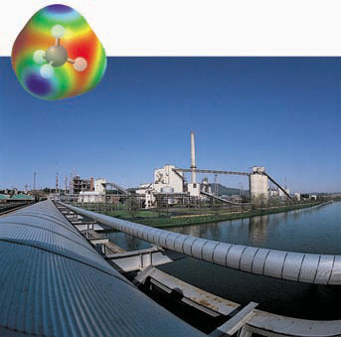
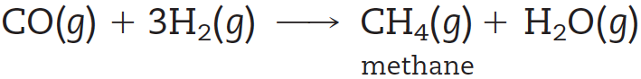
Reversibility of Chemical Reactions
Gaseous fuels can be made by reacting coal with steam to produce a mixture of CO and H₂, which then reacts by catalytic methanation to yield CH₄, the major component of natural gas.
Coal gasification plant
Catalytic methanation is a reversible reaction, and depending on the reaction conditions, the final reaction mixture will have varying amounts of the products as well as the starting substances.
The processes of catalytic methanation and steam reforming illustrate the reversibility of chemical reactions.

Slide 3
Chemical Equilibrium—A Dynamic Equilibrium
When substances react, they eventually form a mixture of reactants and products in dynamic equilibrium.
This dynamic equilibrium consists of a forward reaction, in which substances react to give products, and a reverse reaction, in which products react to give the original reactants. Both forward and reverse reactions occur at the same rate, or speed.
Chemical equilibrium is the state reached by a reaction mixture when the rates of forward and reverse reactions have become equal.

Slide 4
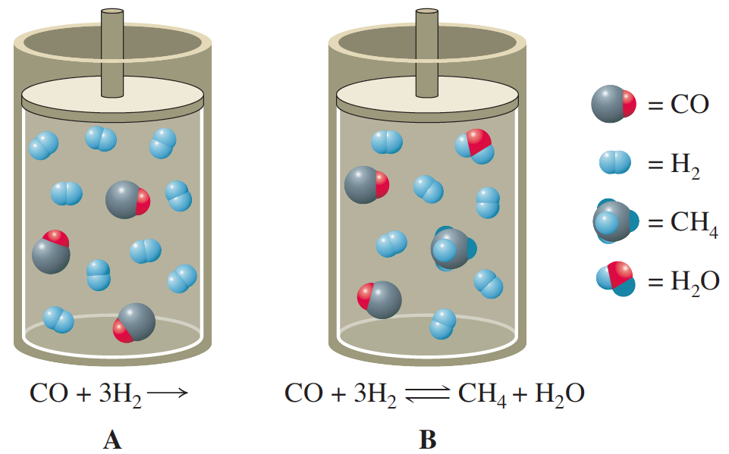
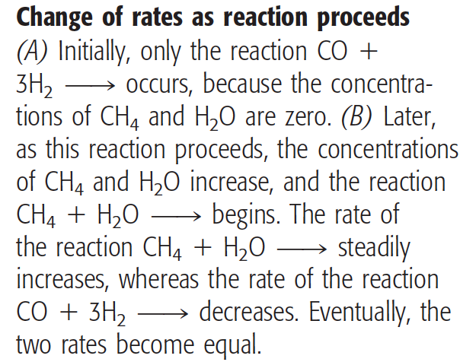
Chemical Equilibrium

Slide 5
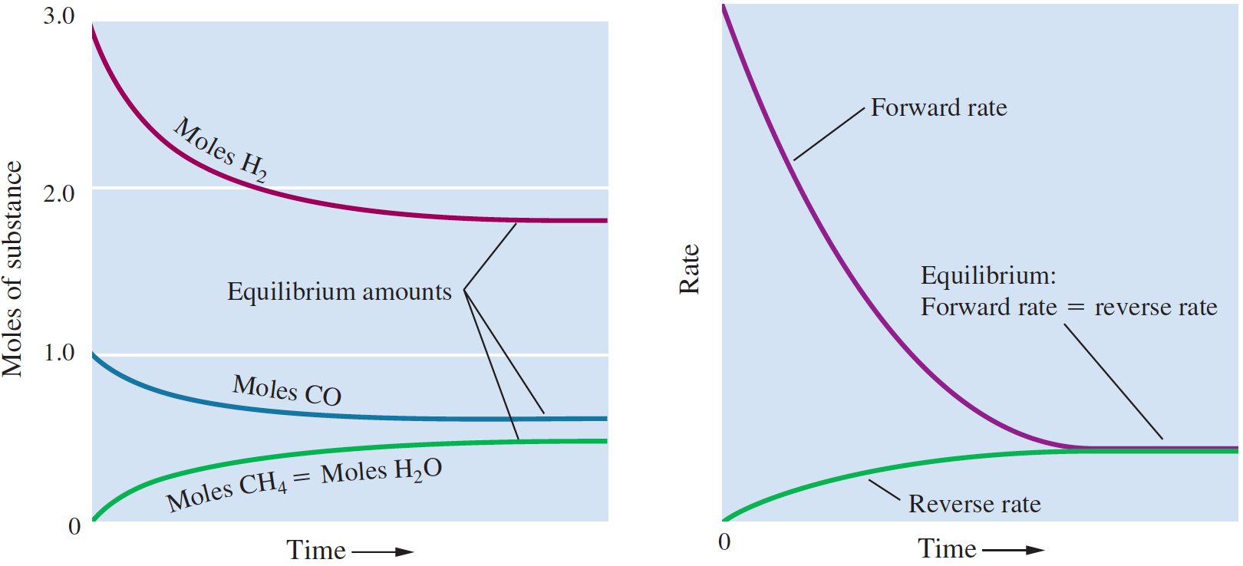
Reaction Approaches Equilibrium
The experiment begins with 1.000 mol CO and 3.000 mol H₂ in a 10.00-L vessel. Note that the amounts of substances become constant at equilibrium.
The forward rate is large at first but steadily decreases, whereas the reverse rate starts at zero and steadily increases. Eventually both rates become equal (at equilibrium).

Slide 6
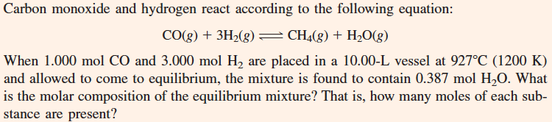
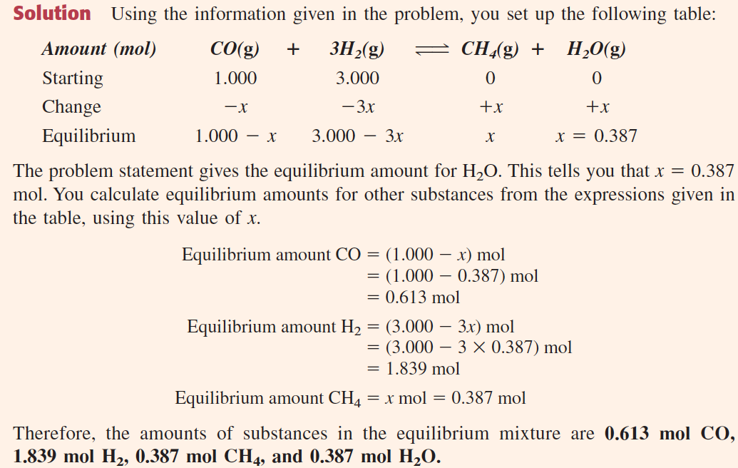

Slide 7
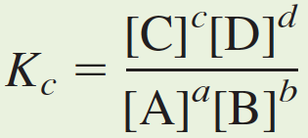
Equilibrium Constant
Consider the reaction
where A, B, C, and D denote reactants and products, and a, b, c, and d are coefficients in the balanced chemical equation. The equilibrium-constant expression for this reaction is
The equilibrium constant K_{c} is defined in terms of molar conc.
The law of mass action is a relation that states that the values of the equilibrium-constant expression Kc are constant for a particular reaction at a given temperature, whatever equilibrium concentrations are substituted.

Slide 8
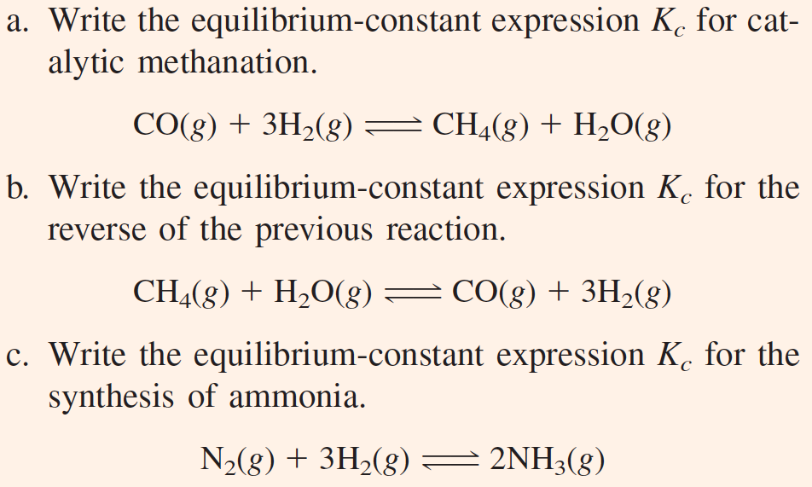
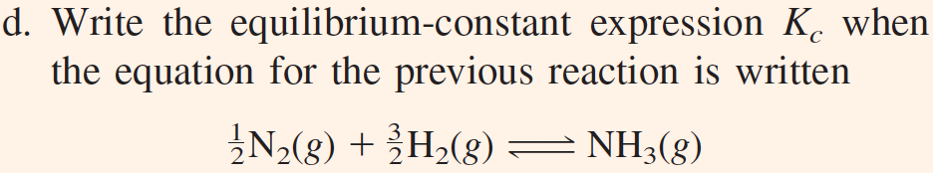

Slide 9
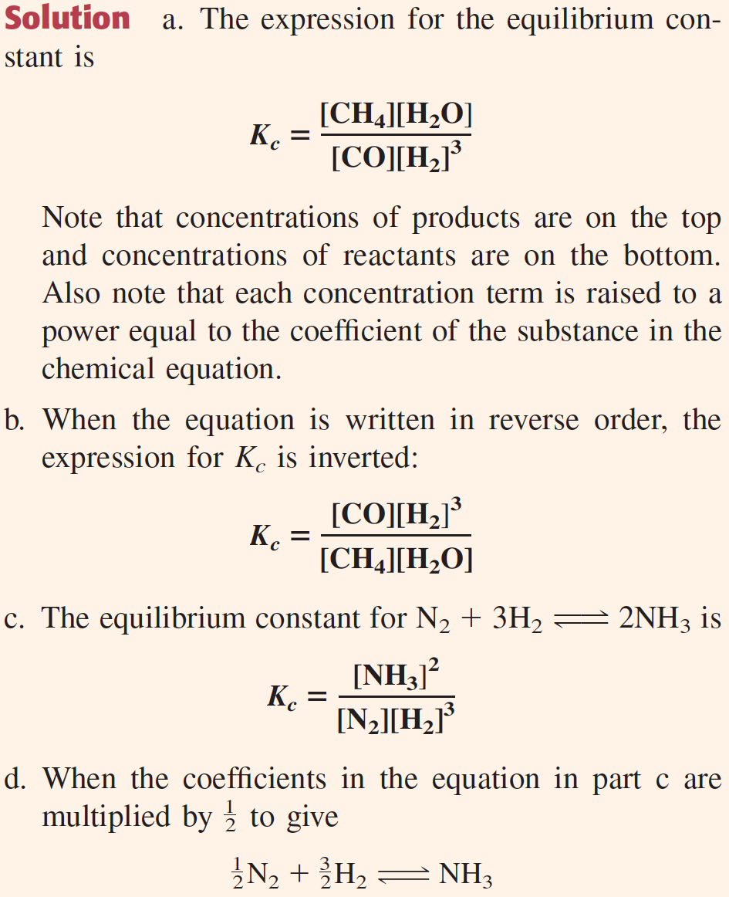
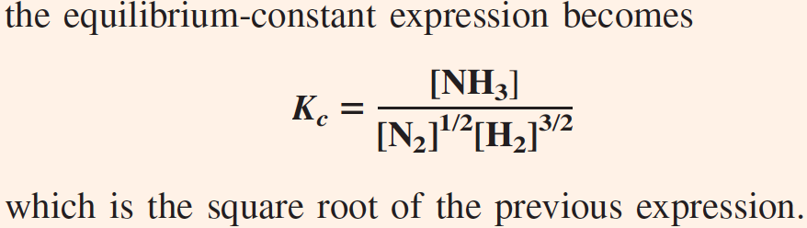

Slide 10
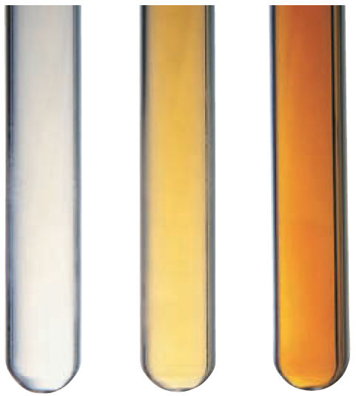
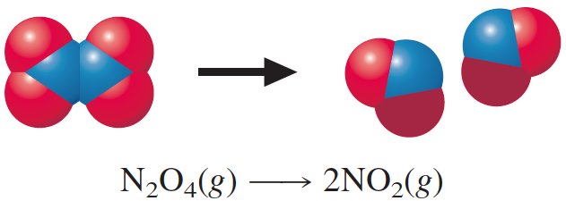
Equilibrium: A Kinetics Argument
Temperature effect on NO₂–N₂O₄ equilibrium
The temperature in the test tubes increases from left to right. N₂O₄ (colorless) predominates at cooler temperatures, whereas NO₂ (reddish brown) predominates at higher temperatures.

Slide 11
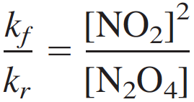
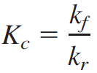
Equilibrium Constant
The rate of the forward reaction is k_{f}[N₂O₄], where k_{f} is the rate constant for the forward reaction.
The rate of the reverse reaction is k_{r}[NO₂]², where k_{r} is the rate constant for the reverse reaction.
At equilibrium: Rate of forward reaction = rate of reverse reaction,
or k_{f}[N₂O₄] = k_{r}[NO₂]²
or
The right side is the equilibrium-constant expression for the decomposition of dinitrogen tetroxide. The left side is the ratio of rate constants. Thus, the equilibrium constant expression is constant for a given temperature and is given by:

Slide 12
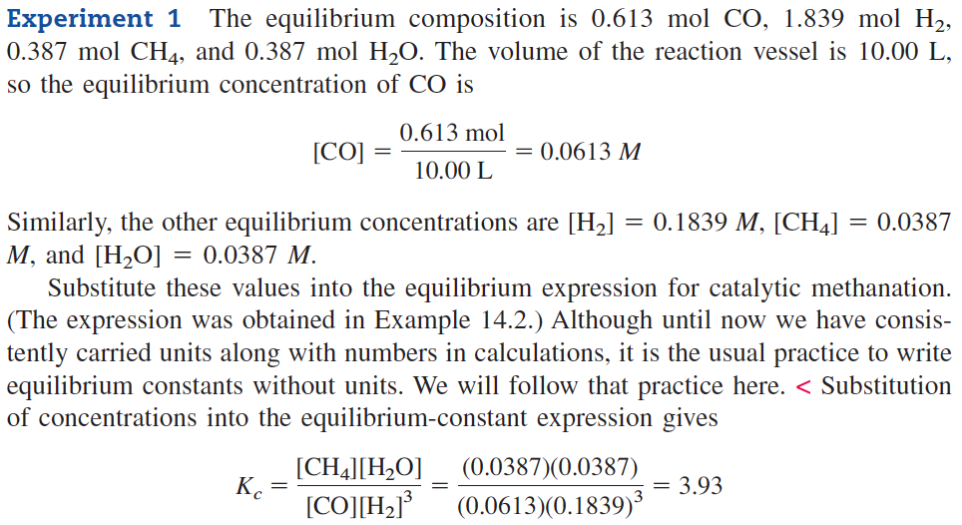
Obtaining K_{c} for Reactions

Slide 13
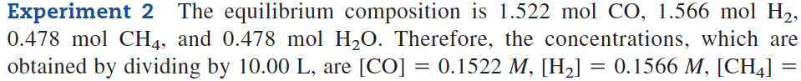
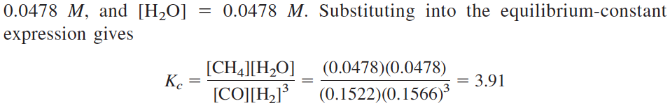
Obtaining K_{c} for Reactions

Slide 14
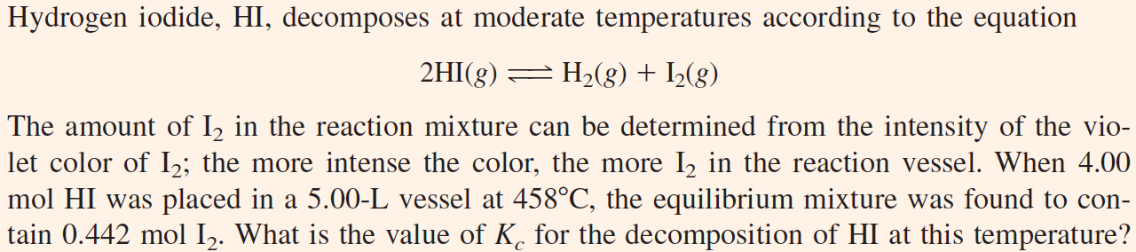
Obtaining K_{c} for Reactions

Slide 15
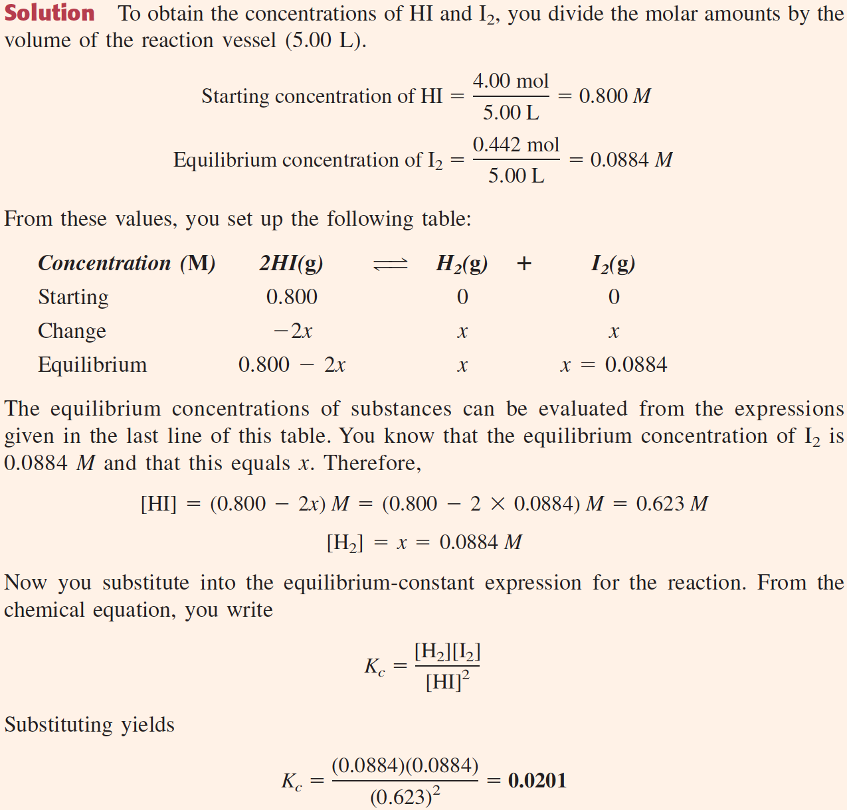

Slide 16
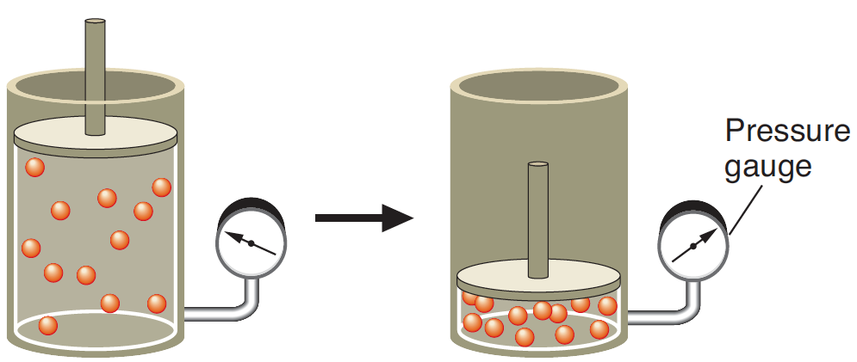
The Equilibrium Constant K_{p}
The concentration of a gas at a given temperature is proportional to the pressure
When the gas is compressed, the pressure increases (as noted from the pressure gauge) and the concentration of the gas (molecules per unit volume) increases.

Slide 17
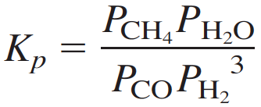
The Equilibrium Constant K_{p}
The concentration of a gas is proportional to its partial pressure at a fixed temperature. You can see this by looking at the ideal gas law, PV = nRT, and solving for n/V, which is the molar concentration of the gas. You get n/V = P/RT. In other words, the molar concentration of a gas equals its partial pressure divided by RT, which is constant at a given temperature.
When you express an equilibrium constant for a gaseous reaction in terms of partial pressures, you call it the equilibrium constant Kp. For catalytic methanation,
the equilibrium expression in terms of partial pressures becomes

Slide 18
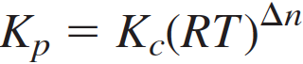
The Equilibrium Constant K_{p}
For catalytic methanation,
the equilibrium expression in terms of partial pressures becomes
In general, the value of K_{p} is different from that of K_{c}. From the relationship for molar concentration n/V = P/RT, one can show that
Where Δn is the sum of the coefficients of gaseous products in the chemical equation minus the sum of the coefficients of gaseous reactants.

Slide 19
The Equilibrium Constant K_{p}
For catalytic methanation,
Where Δn is the sum of the coefficients of gaseous products in the chemical equation minus the sum of the coefficients of gaseous reactants.
For the methanation reaction (K_{c} = 3.92), in which 2 mol of gaseous products (CH₄ + H₂O) are obtained from 4 mol of gaseous reactants (CO + 3H₂), Δn equals 2 – 4 = –2. The usual unit of partial pressures in K_{p} is atmospheres; therefore, the value of R is 0.0821 L.atm/(K.mol). Hence,

Slide 20
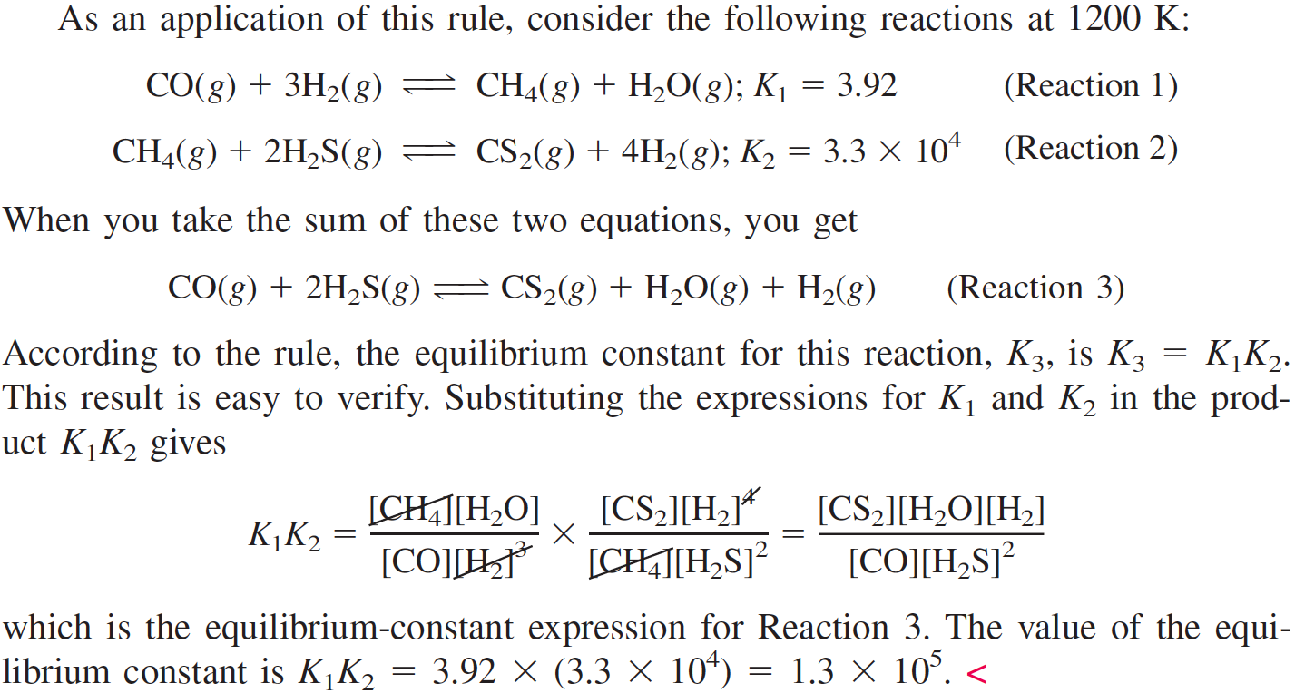
Equilibrium Constant for the Sum of Reactions
If a given chemical equation can be obtained by taking the sum of other equations, the equilibrium constant for the given equation equals the product of the equilibrium constants of the other equations.

Slide 21
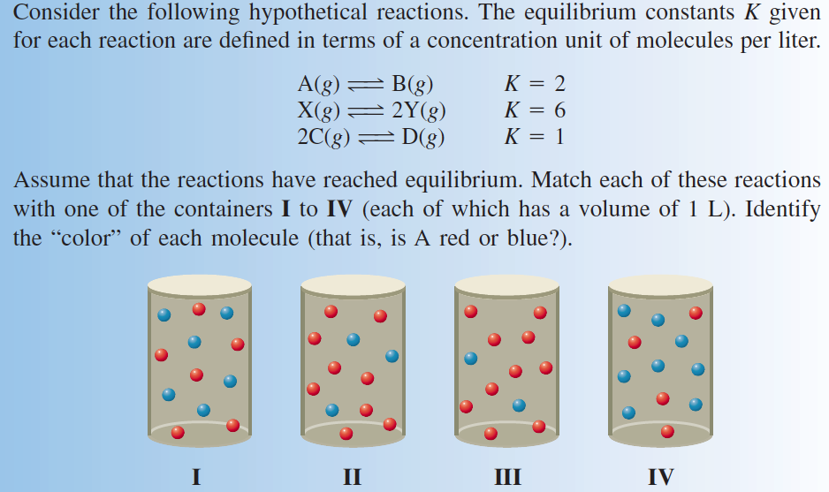

Slide 22
Homogeneous & Heterogeneous Equilibrium
A homogeneous equilibrium is an equilibrium that involves reactants and products in a single phase. Catalytic methanation is an example of a homogeneous equilibrium; it involves only gaseous reactants and products.
On the other hand, a heterogeneous equilibrium is an equilibrium involving reactants and products in more than one phase. For example, the reaction of iron metal filings with steam to produce iron oxide, Fe3O4, and hydrogen involves solid phases, Fe and Fe3O4, in addition to a gaseous phase.

Slide 23
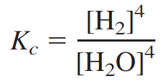
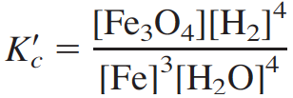
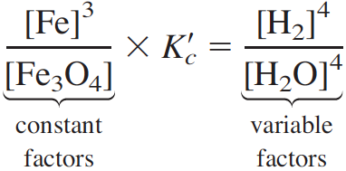
Homogeneous & Heterogeneous Equilibrium
In writing the equilibrium-constant expression for a heterogeneous equilibrium, you omit concentration terms for pure solids and liquids. For the reaction of iron with steam, you would write
To understand why such constant concentrations are omitted in writing K_{c}, write the equilibrium-constant expression for the reaction of iron with steam, but include [Fe] and [Fe₃O₄].
You can rearrange the above equation, putting all of the constant factors on the left side.

Slide 24
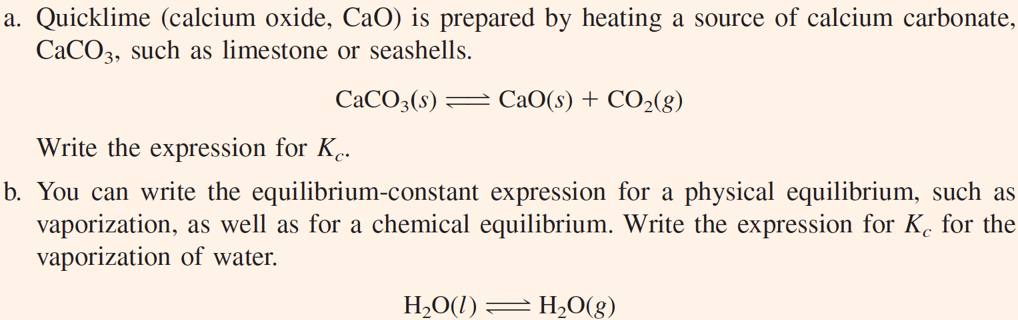
Writing K_{c} for a Reaction with Pure Solids or Liquids

Slide 25
Using the Equilibrium Constant
Qualitatively interpreting the equilibrium constant. By merely looking at the magnitude of Kc, you can tell whether a particular equilibrium favors products or reactants.
Predicting the direction of reaction. Consider a reaction mixture that is not at equilibrium. By substituting the concentrations of substances that exist in a reaction mixture into an expression similar to the equilibrium constant and comparing with Kc, you can predict whether the reaction will proceed toward products or toward reactants (as defined by the way you write the chemical equation).
Calculating equilibrium concentrations. Once you know the value of Kc for a reaction, you can determine the composition at equilibrium for any set of starting concentrations.

Slide 26
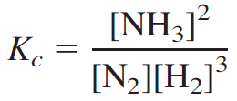
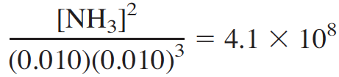
Qualitatively Interpreting K_{c}
If the value of K_{c} is large, the products are favored at equilibrium. Consider the synthesis of ammonia from its elements.
At 25°C the equilibrium constant Kc equals 4.1 × 10⁸. This means that the numerator (product concentrations) is 4.1 × 10⁸ times larger than the denominator (reactant concentrations). Suppose the equilibrium mixture is 0.010 M in N₂ and 0.010 M in H₂.
So, [NH₃] = 2.0 M. The concentrations of N₂ and H₂ are both 0.010 M, so the amount of ammonia formed at equilibrium is 200 times that of any one reactant.

Slide 27
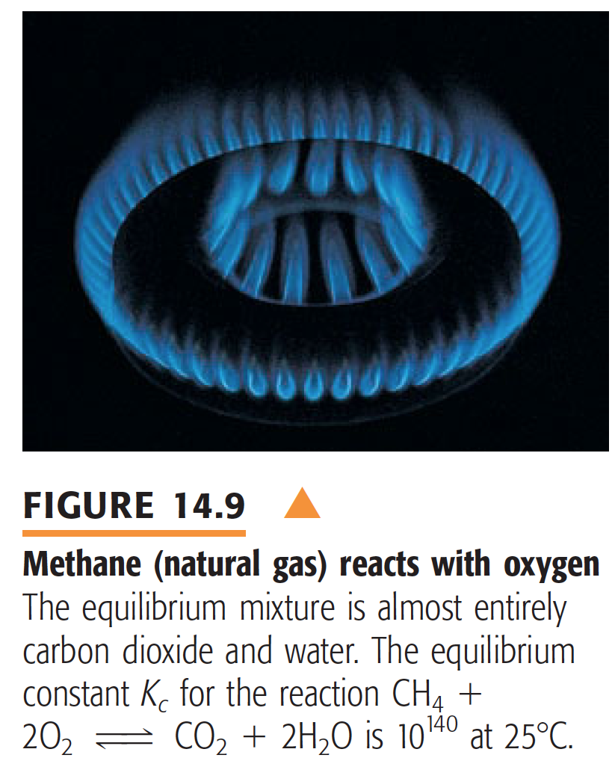
Qualitatively Interpreting K_{c}

Slide 28
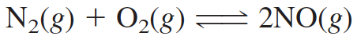
Qualitatively Interpreting K_{c}
If the value of the equilibrium constant is small, the reactants are favored at equilibrium. As an example, consider the reaction of nitrogen and oxygen to give nitrogen monoxide, NO:
The equilibrium constant K_{c} equals 4.6 × 10⁻³¹ at 25°C.
If you assume that the concentrations of N₂ and O₂ are 1.0 M, you find that the concentration of NO is 6.8 × 10⁻¹⁶ M. In this case the equilibrium constant is very small, and the concentration of product is not detectable. Reaction occurs to only a very limited extent.
The equilibrium constant does become large enough at higher
temperatures (about 2000°C) to give appreciable amounts of nitrogen monoxide (nitric oxide). This is why air (N₂ + O₂) in flames and in auto engines becomes a source of the pollutant NO.

Slide 29
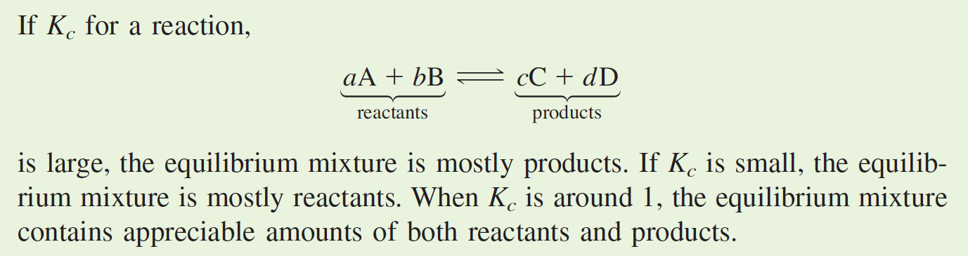
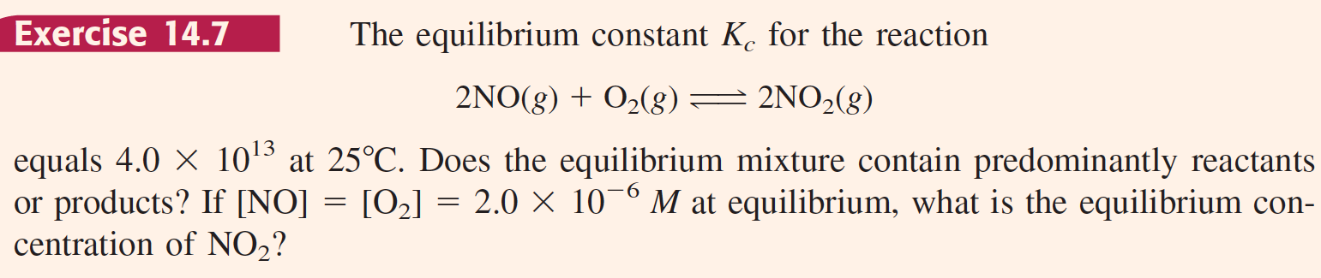
Qualitatively Interpreting K_{c}
Homework

Slide 30
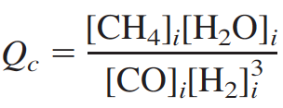
Reaction Quotient
The reaction quotient, Q_{c}, is an expression that has the same form as the equilibrium-constant expression but whose concentration values are not necessarily those at equilibrium.
For catalytic methanation,
the reaction quotient is
where the subscript i indicates concentrations at a particular instant i.

Slide 31
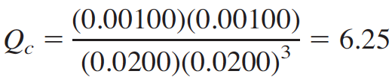
Using the Reaction Quotient
Suppose a gaseous mixture from an industrial plant has the following composition at 1200 K: 0.0200 M CO, 0.0200 M H₂, 0.00100 M CH₄, and 0.00100 M H₂O. If the mixture is passed over a catalyst at 1200 K, would the reaction go toward the right or the left?
To answer this question, you substitute the concentrations of substances into the reaction quotient and compare its value to K_{c}. The reaction quotient is
Recall that the equilibrium constant K_{c} for catalytic methanation is 3.92 at 1200 K. For the reaction mixture to go to equilibrium, the value of Q_{c} must decrease from 6.25 to 3.92. This will happen if the reaction goes to the left. In that case, the numerator of Q_{c} ([CH₄]_{i}[H₂O]_{i}) will decrease, and the denominator ([CO]_{i}[H₂]_{i}³ ) will increase. Thus, the gaseous mixture will give more CO and H₂.

Slide 32
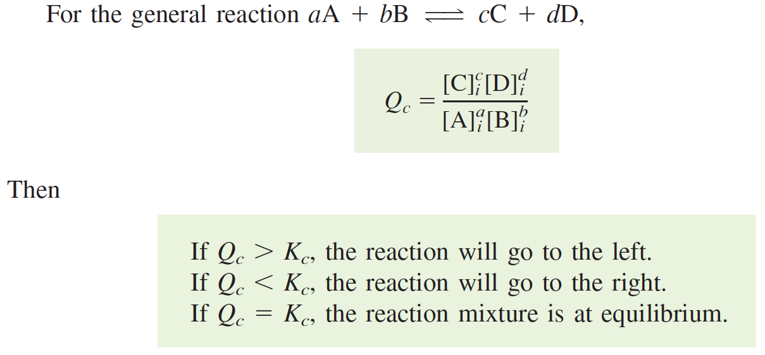
Using the Reaction Quotient

Slide 33
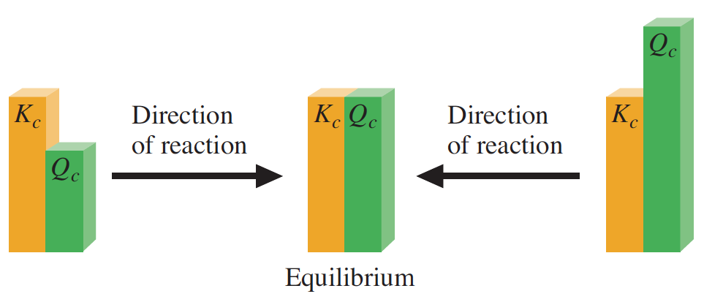
Using the Reaction Quotient

Slide 34
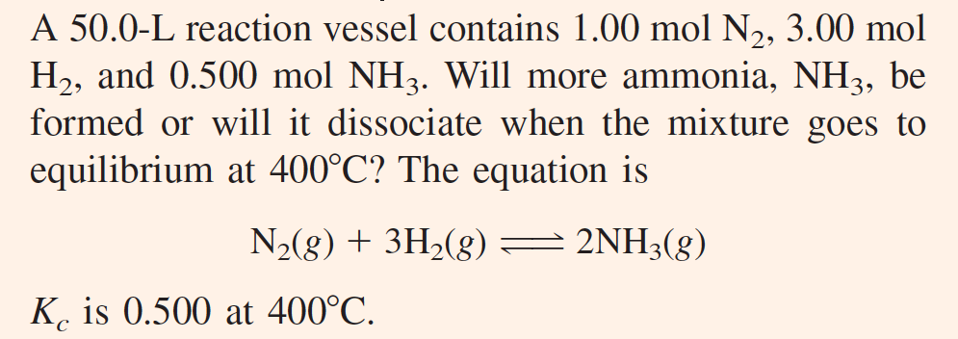
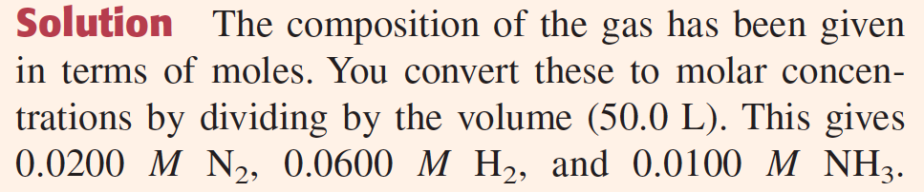
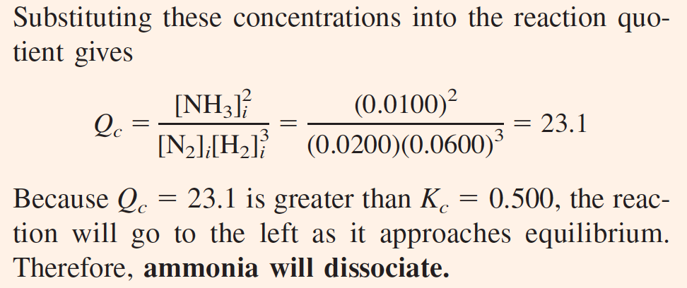

Slide 35
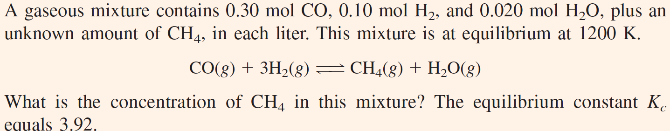

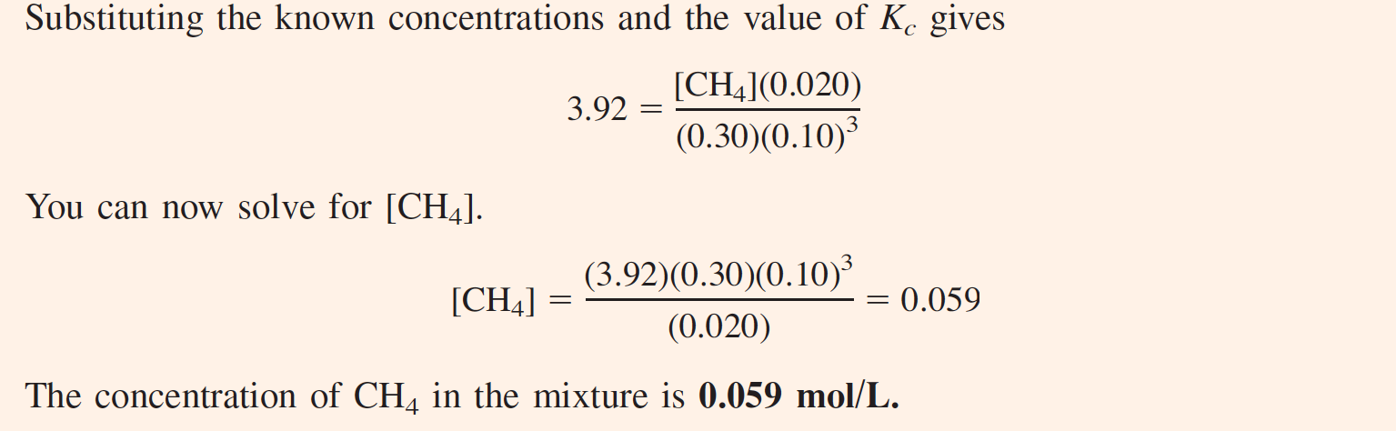

Slide 36
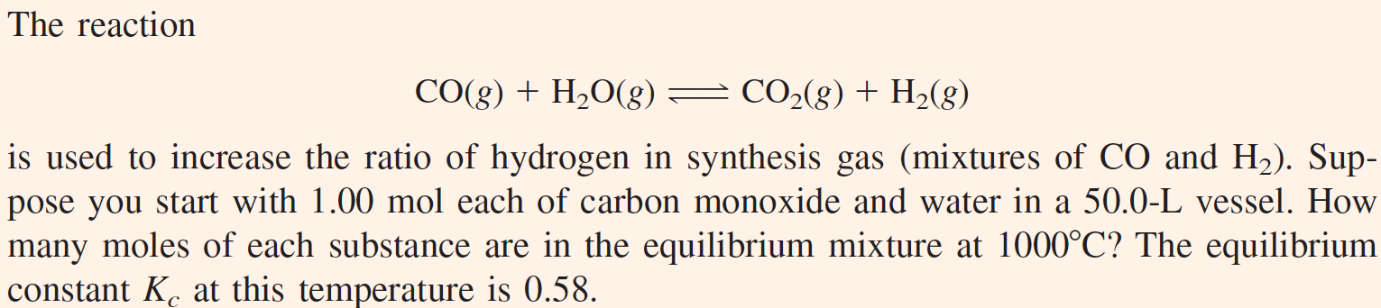
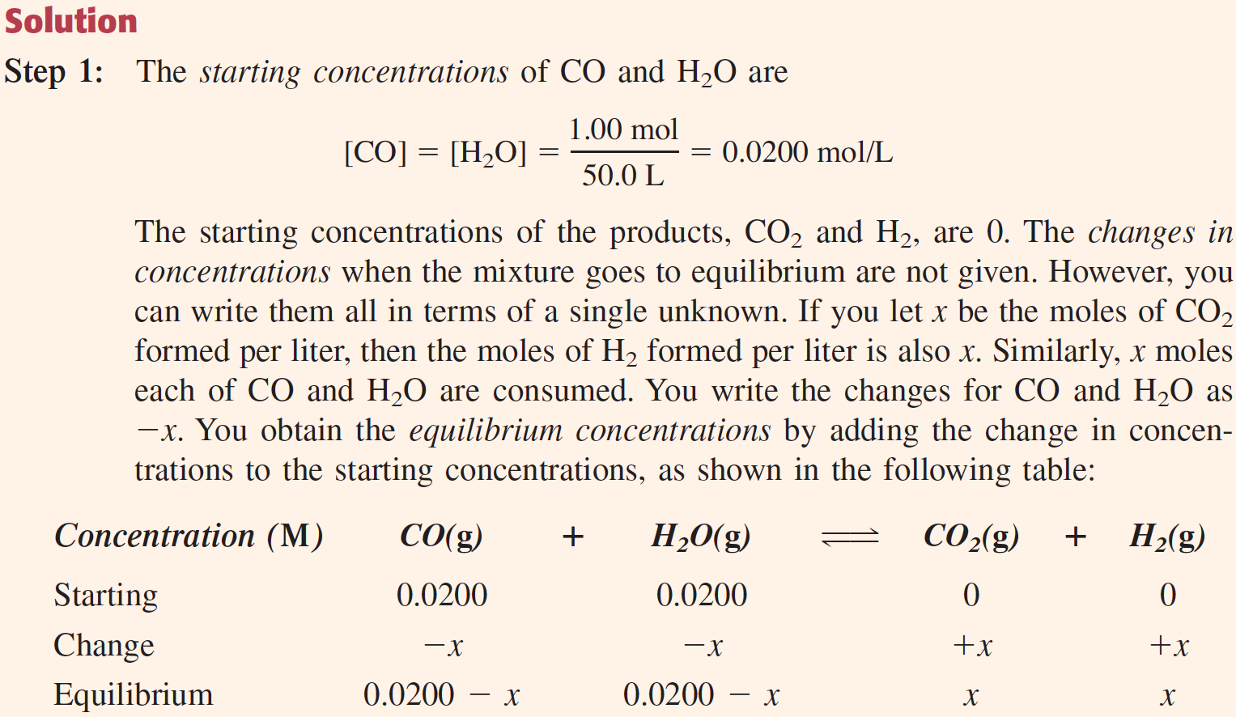

Slide 37
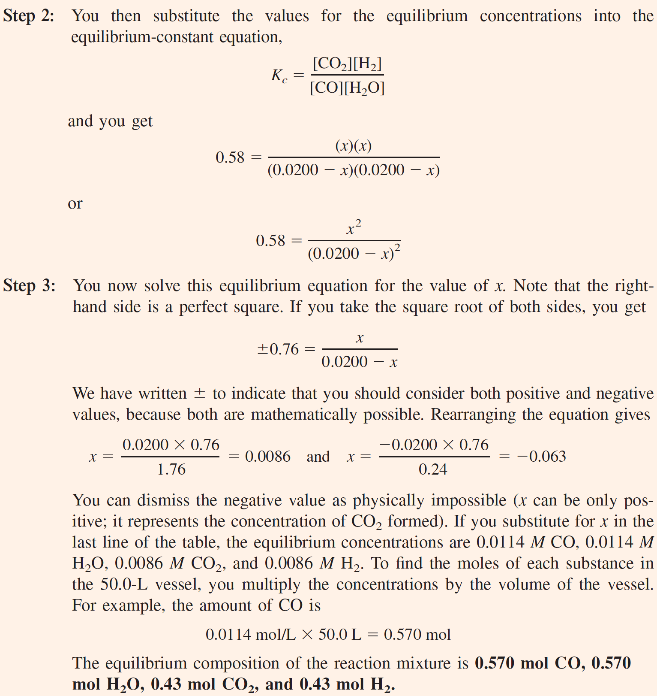

Slide 38
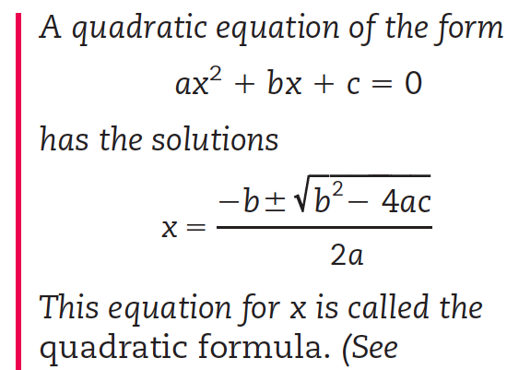
Steps Used to Solve for Equilibrium Concentrations
1. Set up a table of concentrations (starting, change, and equilibrium expressions in x).
2. Substitute the expressions in x for equilibrium concentrations into the equilibrium-constant equation.
3. Solve the equilibrium-constant equation for the values of the equilibrium concentrations.

Slide 39
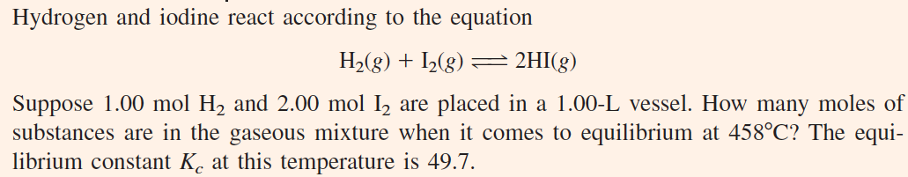


Slide 40


Slide 41
Changing the Reaction Conditions: Le Châtelier’s Principle
Obtaining the maximum amount of product from a reaction depends on the proper selection of reaction conditions. By changing these conditions, you can increase or decrease the yield of product. There are three ways to alter the equilibrium composition and possibly increase the yield of product:
Changing the concentrations by removing products or adding reactants to the reaction vessel.
Changing the partial pressure of gaseous reactants and products by changing the volume.
Changing the temperature.
A catalyst cannot alter equilibrium composition, although it can change the rate at which a product is formed and affect the result.

Slide 42
Removing Products or Adding Reactants
Consider the methanation reaction,
If you place 1.000 mol CO and 3.000 mol H₂ in a 10.00-L reaction vessel, the equilibrium composition at 1200 K is 0.613 mol CO, 1.839 mol H₂, 0.387 mol CH₄, and 0.387 mol H₂O. Can you alter this composition by removing or adding one of the substances to improve the yield of methane?
To answer this question, you can apply Le Châtelier’s principle, which states that
“when a system in chemical equilibrium is disturbed by a change of temperature, pressure, or a concentration, the system shifts in equilibrium composition in a way that tends to counteract this change of variable.”

Slide 43


Slide 44


